Slide 1
American Sign Language Recognition Project
ECE532 GROUP 4

Slide 2
Introduction
Communication is a vital part of everyday life. However, certain disabilities may prevent individuals from the most basic means of communication: listening and talking.
Not everyone knows sign language, and thus creating a communication barrier.
Our project aims to bridge this gap.

Slide 3
Initial Goal
The initial goal of this project was to develop a system that is able to recognize the hand gestures of the 26 letters and 10 numbers of the American Sign Language (ASL), and translate them into text display.

Slide 4
What We Have Now
Problems
Changes
one of our group members dropped the course
had hard time with pin mapping
tool issues
getting consistent sensor readings
time
removed camera from our design
added some buttons to get more information about hand position
used the ADC port on the board instead of external one

Slide 5
Design Details

Slide 6
Initial Block Diagram

Slide 7
IP Used
IP Created/Modified
IP Grabbed
ASL
ACCEL
ADC
TFT
Microblaze
MIG
Uartlite
GPIO
Slice
SPI

Slide 8
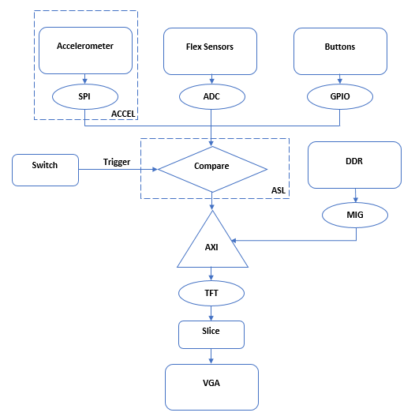
Final Block Diagram

Slide 9
Design Process
Road to Success
Management
Parallelized workload
Assigned work based on team members’ strengths
Test individual parts before combining
Helping one another when team members were busy with other commitments
Trust in team members to accomplish tasks
Internal deadlines/milestones
Weekly meetings
Constant communication

Slide 10
What We Learned
Divide work as much as possible to be efficient
Plan time well, ask questions in advance
Analyze design for potential failures, and have a backup plan
Always communicate any changes immediately
Purchase hardware as early as possible

Slide 11
Thank You!
Questions?

